Slide 1
Cleaning, Maintenance and
Storage of Equipment

Slide 2
Aim
If the vital tasks of cleaning, maintaining and storing equipment are not carried out properly the next operation has a great chance of failure

Slide 3
Outline
Cleaning
Maintenance
Storage
Reimbursement

Slide 4
Part One
Cleaning of equipment
after training and operations

Slide 5
Cleaning after Training
Salt corrodes: clean with non-saline water
Containment booms
  All sides of booms
  All steel parts
  Power packs if in contact with seawater
  Hydraulic couplings
Skimmers
  All steel parts
  Grease while connected to power pack

Slide 6
Cleaning after Operations
Clean in an area with oil separator
Clean as after use as possible
Use high pressure equipment
Finalise by flushing with fresh water
Do not clean booms on deck

Slide 7
Cleaning Booms
Clean heavily contaminated booms manually by applying diesel oil with brush
After 30 min. use high pressure cleaner with hot water or steam
Keep nozzle 10-20 cm from fabric
Use scrapers carefully to remove sticky oil pads

Slide 8
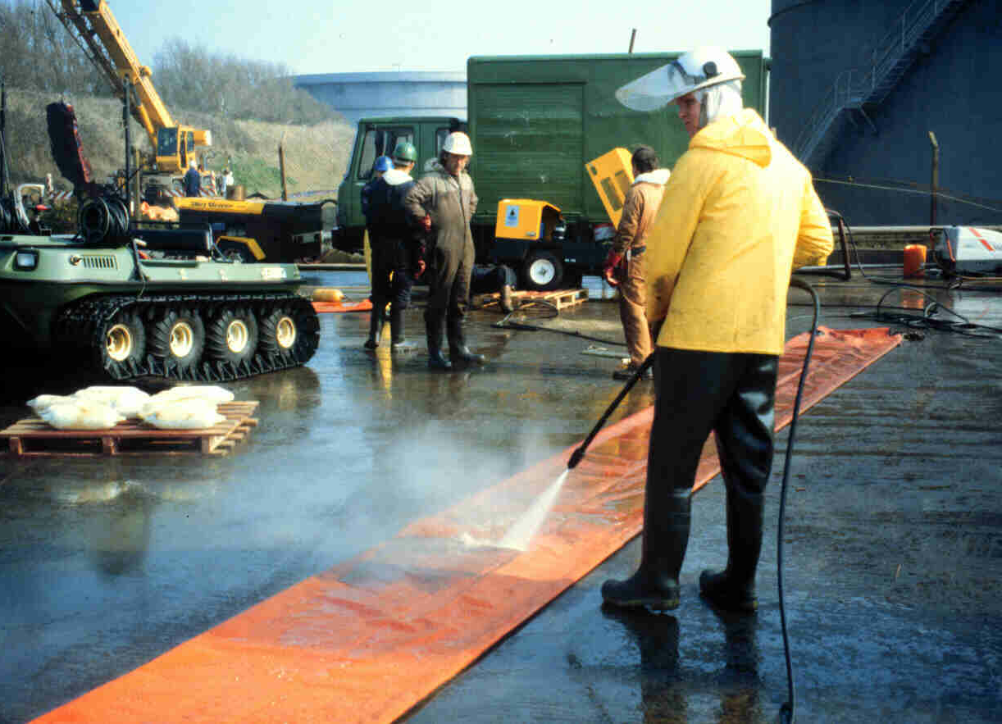
Cleaning Booms
Source: OSRL

Slide 9
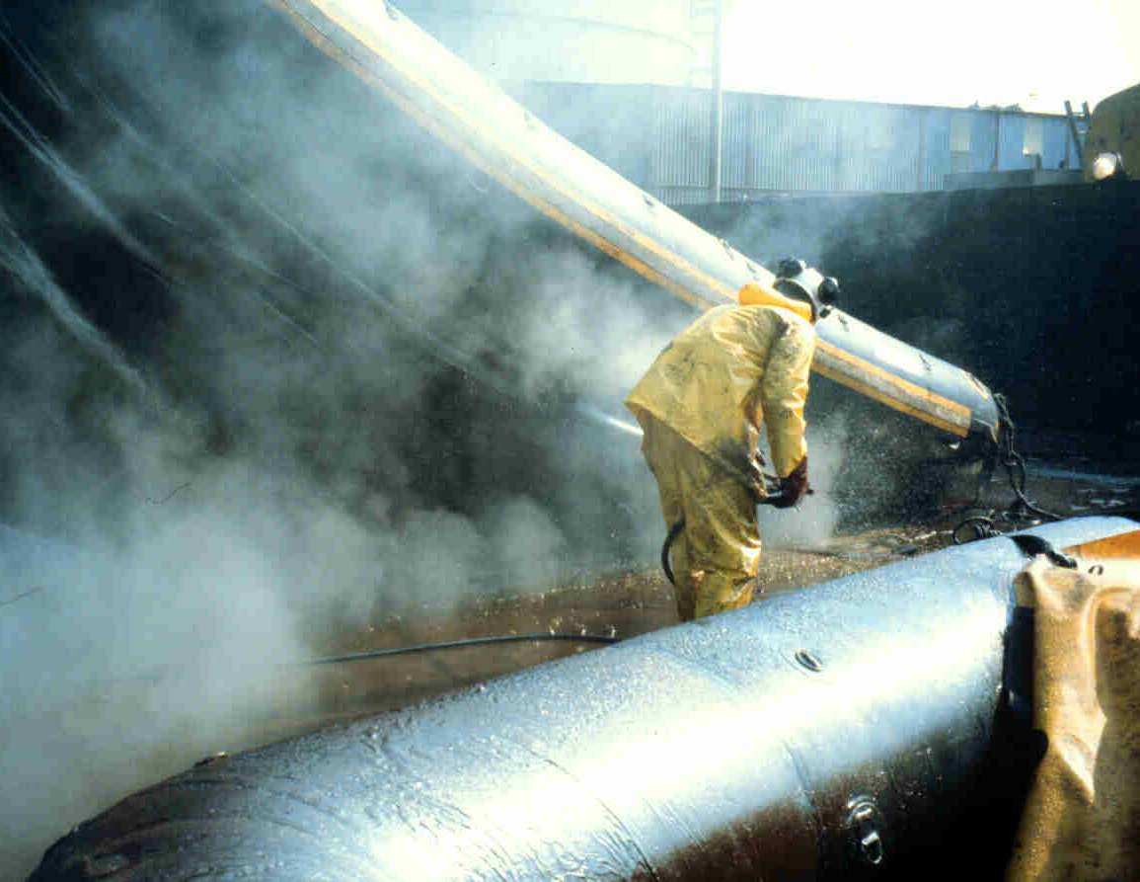
Cleaning Booms
Source: OSRL

Slide 10
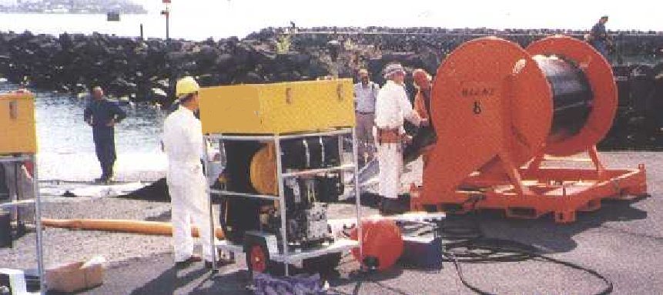
Customised Boom with Auxiliary Equipment

Slide 11
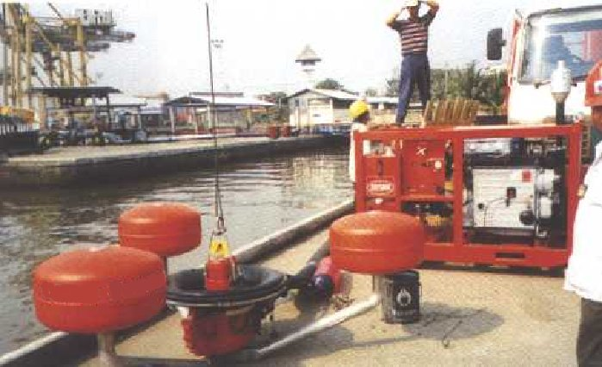
Skimmer with Auxiliary Equipment

Slide 12
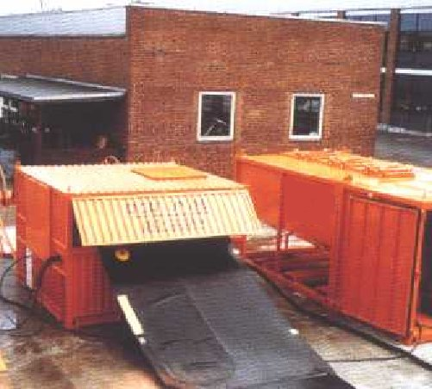
Cleaning Container

Slide 13
Cleaning Skimmers
Clean all metal parts, especially couplings, with high pressure cleaners
Flush with fresh water
Lubricate pump and grease moving parts

Slide 14
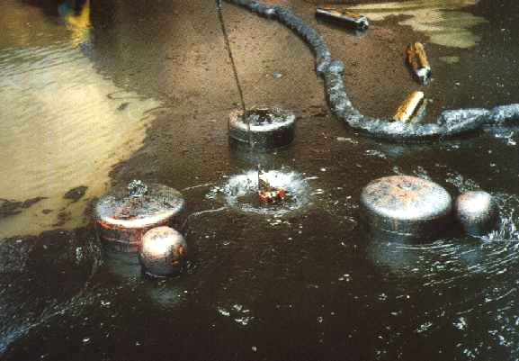
Contaminated Skimmer

Slide 15
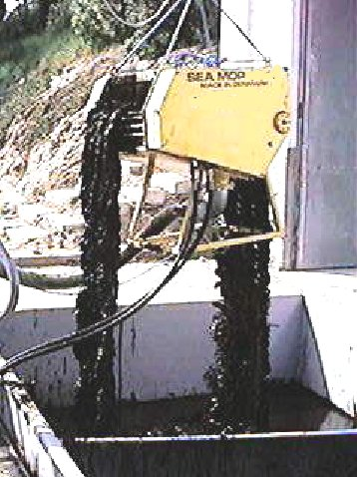
Contaminated Mop Skimmer

Slide 16
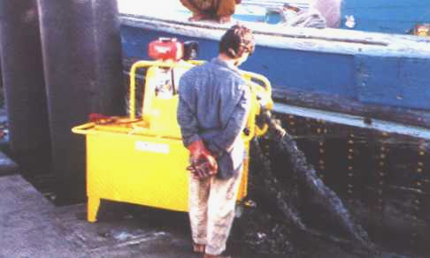
Contaminated Mop Skimmer

Slide 17
Part Two
Maintaining oil spill combating equipment

Slide 18
Keeping Boom Logs
When used
Training or operations
Damages (what kind)
Repairs (where, when)
Maintenance of storage unit (winder)

Slide 19
Common Damage Areas
Air Valve
Vertical Lattice
Section Connector
Wear and Tear of Fabric
Ballast Attachment
Chain

Slide 20
Suggestion for a Log Book Format
EQUIPMENT: CONTAINMENT BOOM
TYPE : ACME 100
SUPPLIED: FEB 2003
OPERATIONAL RECORDS
Feb 2003: Checked on delivery
March 2003: Used on Training Course
August 2003: Used on Training Course
Feb 2004: At sea (incident 02/04). 100 tonnes light diesel oil.
June 2004: Used in bi-lateral training exercise.

Slide 21
Suggestion for a Log Book Format
EQUIPMENT: CONTAINMENT BOOM
TYPE : ACME 100
SUPPLIED: FEB 2003
CLEANING/MAINTENANCE REPAIR
Feb 03: Checked on Delivery (by MNN) Sections numbered (by SSR)
March 03.Light Cleaning-low pressure fresh water(by course members)
August 03. Light cleanings as above mechanical damage to section M. (SSR)
Returned to manufacturers for repair by MNN.
Feb 04 Sea Water High pressure flush. No damage. Condition Still suitable for Training and Exercises.

Slide 22
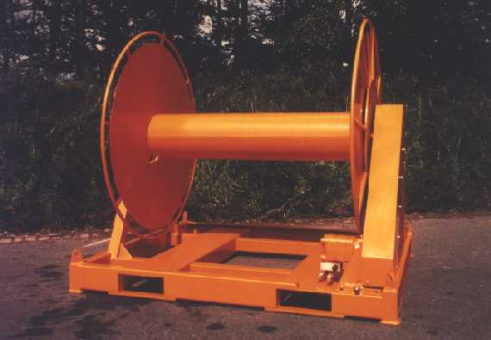
Winder

Slide 23
Maintenance of Winders
Grease moving parts after cleaning
Check oil levels in gear housings if hydraulically driven
Check grease nipples for damage or blockages

Slide 24
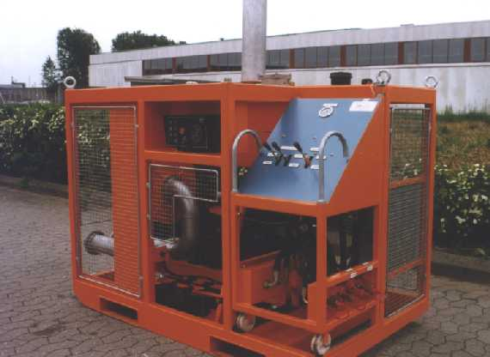
Power Packs

Slide 25
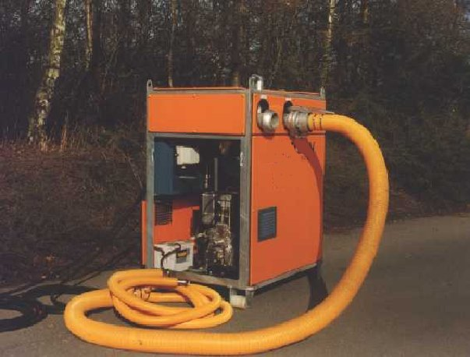
Power Packs

Slide 26
Maintenance of Power Packs
Run diesel engines at least once a month
Examine for oil leaks
Check v-belts
Check hydraulic system and oil levels
Spray air blowers with silicon or lubricating oil

Slide 27
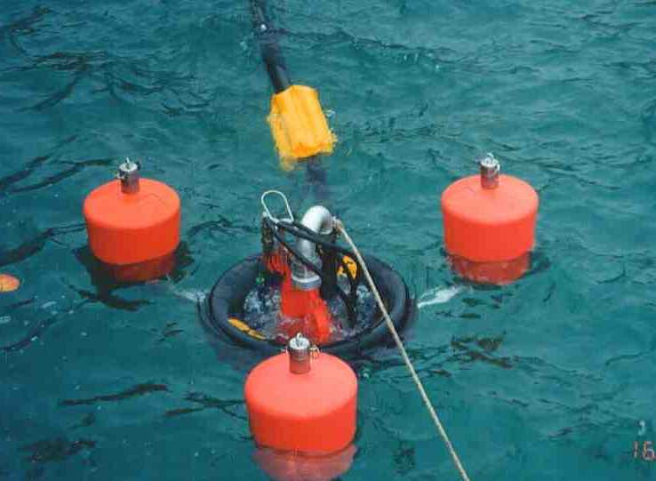
Skimmer

Slide 28
Maintenance of Skimmers
When cleaned and lubricated, skimmers normally need no further maintenance
Check hydraulic units for leaks and oil levels
Grease all moving parts

Slide 29
Part Three
How to store oil spill
combating equipment

Slide 30
Guide to Storage
Away from direct sunlight
No vermin
Dry and well ventilated
-20 to + 60 degree C
Easy access for easy maintenance
Concealed and secure
Equipment lists and storage location

Slide 31
Claims for Reimbursement
Keep comprehensive records of all personnel, equipment and consumables
Use standard work sheets
Record actions taken at specific sites

